Slide 1


Group 1

Slide 2

Over production of farmers and too much mortgage and credit problems in the farming industry
A series of droughts hit the Midwest
Over tilling and exposure of the land and didn’t use it
Over production of manufacturers, over use of credit, too much inventory

Slide 3
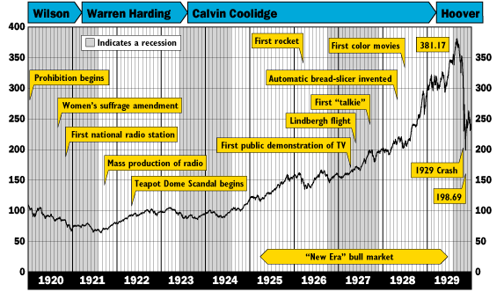


Slide 4
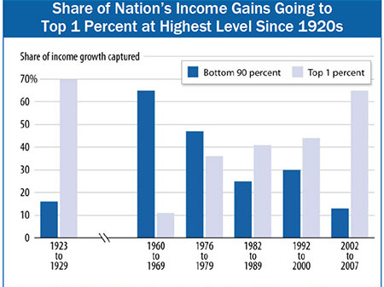

Slide 5

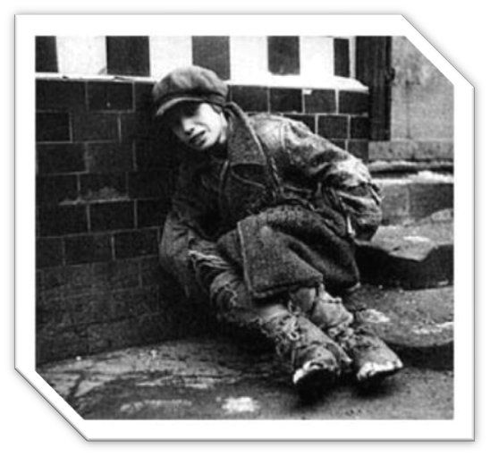
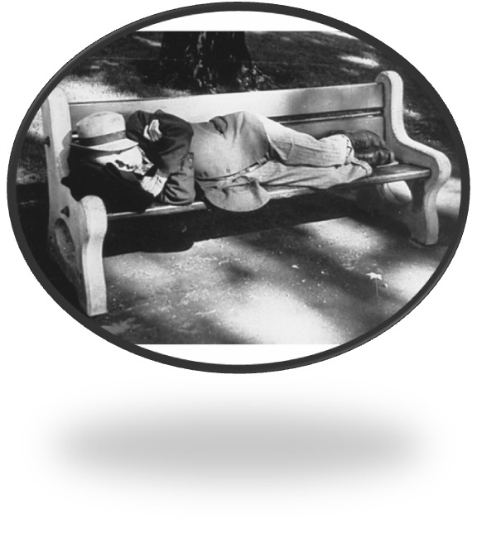
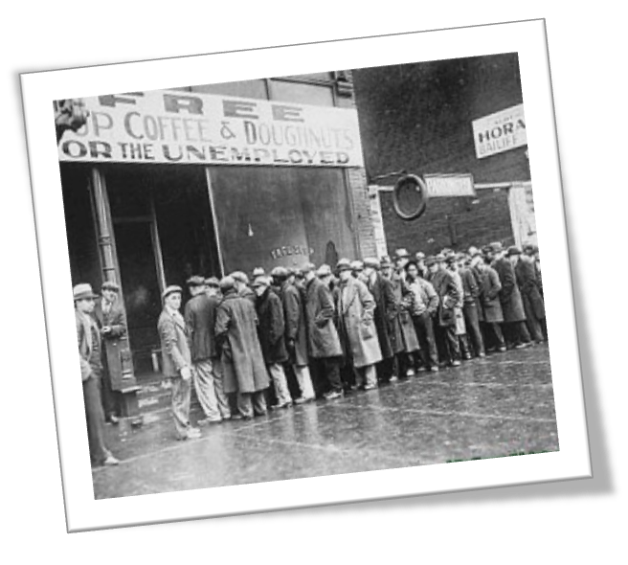
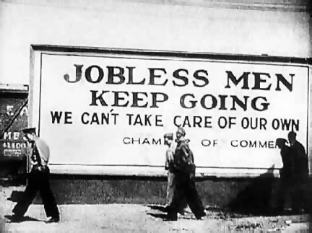

Slide 6
Songs From the Depression
Playing Now: Brother, Can You Spare me a Dime? By Rudy Valley
Click Here to play: We’d Like to Thank You Herbert Hoover.

Slide 7
Conditions of the Depression
On “Black Tuesday,” October 29, 1929, the market lost $14 billion, making the loss for that week an astounding $30 billion. This was ten times more than the annual federal budget and far more than the U.S. had spent in WWI.^{e} Thirty billion dollars would be equivalent to $377,587,032,770.41 today
The “Three Little Pigs“—released May 27, 1933, and produced by Walt Disney—was seen as symbolic of the Great Depression, with the wolf representing the Depression and the three little pigs representing average citizens who eventually succeeded by working together.
During the Great Depression, many people tried apple selling to avoid the shame of panhandling. In New York City alone, there were as many as 6,000 apple sellers
The Great Depression changed the family in several ways. Many couples delayed marriage, and divorce rates and birth rates dropped. Some men also abandoned their families; a 1940 poll revealed that 1.5 million married women were abandoned by their husbands

Slide 8
Examples of the Depression
The Dust Bowl was a period of droughts in the Mid west in the ‘20s and ‘30s
If the deserving poor had been few then charitable help might have sufficed
The Depression gave the middle class a double vision of the poor
Most rich people were involved in the stock market and became broke but not all were affected
Rural life: Weather touched every part of life in the "Dirty 30s": dust, insects, summer heat and winter cold. When the dryness, heat, and grasshoppers destroyed the crops, farmers were left with no money to buy groceries or make farm payments. Some people lost hope and moved away
City life: “This picture is so grim that whatever words I use will seem hysterical and exaggerated. And I find them all in the same shape - fear, fear driving them into a state of semi-collapse cracking nerves; and an overpowering terror of the future.... They can't pay rent and are evicted. They are watching their children grow thinner and thinner; fearing the cold for children who have neither coats nor shoes; wondering about coal.”
African-Americans were the hardest hit during the Great Depression, and they were often the first to get laid off

Slide 9
Examples of the Depression
Survival tactics included men and women huddling around bonfire to keep warm, picking through garbage for scraps of food, living in sewer pipes manufacturers could not sell, and women burned newspapers in vacant lots to warm their baby’s bottles.
Types of help offered: left over systems, eating clubs, portions of salaries were donated to the poor
President Hoover’s policy included Laissez Faire economics meaning a “hands off” policy. This allowed for rapid industrialization without government regulation.
Poor conditions: shack towns, Kentucky miners, debts, dust storms, shantytowns and Hoovervilles
Eating tight: usually ate bread, macaroni, potatoes, and spaghetti; food was not adequate

Slide 10
Examples of the Depression
Evictions: housing market went down so they couldn’t pay their rent; they just built shacks to live in

Slide 11
Three Presidents of the Twenties and Common Goals
Presidents
Common Goals
Warren G. Harding
Calvin Coolidge
Herbert Hoover
All believed in the use of the radios to talk to the people
Believed in small government
Believed that the poor was to be blamed for their own condition

Slide 12
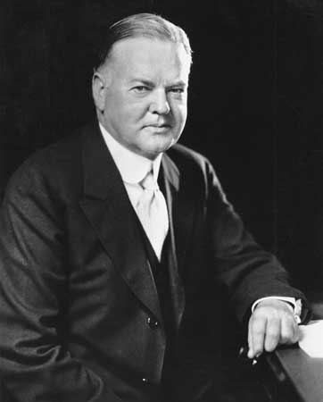
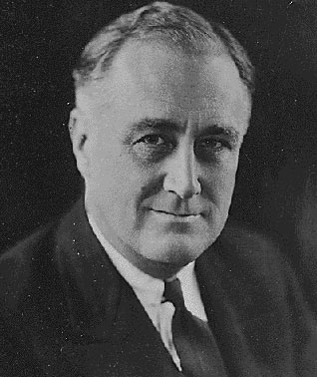
President Hoover
President Roosevelt

Slide 13
Bio of President Harding
Was born November 2, 1865 near Blooming Grove Ohio
Died August 2, 1923
Republican from Ohio
First incumbent US senator and first newspaper publisher to be elected
Was the 28th governor lieutenant governor of Ohio
Did not agree with the League of Nations and thus signed a separate peace treaty with Germany and Austria
Strongly promoted world Naval disarmament
Signed he first child welfare program in the United States
Collapsed and died on a trip in California
Was succeeded by Vice president Calvin Coolidge

Slide 14
Bio of President Coolidge
Was born on July 4th, 1872
Died on January 5th, 1933
Was a republican lawyer from Vermont
Was the 29th Vice President, succeeded William Hardin
Was the 48th governor of Massachusetts
Was the 46th lieutenant governor of Massachusetts
His work the Boston Police Strike brought him into national spotlight
Expressed the opinions and wants of the middle class
Was president from 1923-1929
Held programs reducing the size of government

Slide 15
Bio of President Hoover
  (August 10, 1874 – October 20, 1964) West Branch, Iowa.
  Hoover was originally a professional mining engineer and author.
  His father died in 1880, and his mother in 1884, leaving Hoover an orphan at the age of nine.
  Though he did not attend high school, the young Hoover attended night school and learned bookkeeping, typing, and math.^{[2]}
  Hoover married his Stanford sweetheart, Lou Henry, in 1899
  After being appointed as mine manager at the age of 23, he led a major program of expansion for the Sons of Gwalia gold mine at Gwalia, Western Australia
  Humanitarian in WWI, aiding in evacuation Americans from Europe and the distribution of food to over nine million war victims.
  Provided aid to Germany and war-torn Bolshevik nations after the war, despite Republican oppression.
  Had a landslide victory in the general election with 58% of the vote.
  Presidency lasted from 1928-1933.

Slide 16
Campaign Mottos
Herbert Hoover – A chicken in every pot and a car in every garage.
Calvin Coolidge – Keep cool with Coolidge.
William G. Harding – Return to normalcy.

Slide 17
Terms
Brain trust: group of close advisors to a political candidate or incumbent, prized for their expertise in particular fields
Black cabinet: first known as the Federal Council of Negro Affairs, an informal group of African-American public policy advisors to President Roosevelt
The first 100 days: Roosevelt responded to Americans’ demands with a series of new programs, in which he met with Congress for 100 days
Fire Side Chats: a series of 30 evening radio speeches given by President Roosevelt
Buying on Margin: The purchase of an asset by paying the margin and borrowing the balance from a bank or broker.
  Black Tuesday: Also known as the Great Crash, and the Stock Market Crash of 1929, was the most devastating stock market crash in the history of the United States

Slide 18
Terms
Bull Market: It describes the upward and downward market trends, respectively, and can be used to describe either the market as a whole or specific sectors and securities
  Packing the Court: This was a legislative initiative proposed by U.S. President Franklin Roosevelt to add more justices to the U.S. Supreme Court. Roosevelt's purpose was to obtain favorable rulings regarding New Deal legislation that had been previously ruled unconstitutional.
  Francis Perkins: She was the U.S. Secretary of Labor from 1933 to 1945, and the first woman appointed to the U.S. Cabinet. As a loyal supporter of her friend, Franklin D. Roosevelt, she helped pull the labor movement into the New Deal coalition.

Slide 19
4 Important Actions of Eleanor Roosevelt
1) Co-Founder of the Freedom House, an international non-governmental organization that conduced research on democracy, political freedom, and human rights.
2) She was an activist for the New Deal coalition, which supported the New Deal, a series of economic programs
3) She founded the UN Association of the United States in order to advance support for the formation of the United Nations.
4) During her delegacy at the UN she chaired the committee that drafted and approved the Universal Declaration of Human Rights.

Slide 20
Legislation of the New Deal
Emergency Banking Act (March 9):provided the president with the means to reopen viable banks and regulate banking
Economy Act (March 20): cut federal costs through reorganization of and cuts in salaries and veterans' pensions
Beer-Wine Revenue Act (March 22): legalized and taxed wine and beer
Civilian Conservation Corps Act (March 31): Three million young men, between the ages of 18 to 25, found work in road building, forestry labor and flood control through the establishment of the Civilian Conservation Corps (CCC)
Federal Emergency Relief Act (May 12): established the Federal Emergency Relief Administration to distribute $500 million to states and localities for relief. Administered by Harry Hopkins for relief or for wages on public works, that federal agency would eventually pay out about $3 billion
Agricultural Adjustment Act (May 12): established the Agricultural Adjustment Administration to decrease crop surpluses by subsidizing farmers who voluntarily cut back on production
Thomas Amendment to the Agricultural Adjustment Act: permitted the president to inflate the currency in various ways
Tennessee Valley Authority Act (May 18): allowed the federal government to build dams and power plants in the Tennessee Valley, coupled with agricultural and industrial planning, to generate and sell the power, and to engage in area development. The TVA was given an assignment to improve the economic and social circumstances of the people living in the river basin
Federal Securities Act (May 27): to stiffen regulation of the securities business.
National Employment System Act (June 6): to create the U.S. Employment Service
Home Owners Refinancing Act (June 13): to establish the Home Owners Loan
Corporation (HOLC) :to refinance non-farm home mortgages
Glass-Steagall Banking Act (June 16): to institute various banking reforms, including establishing the Federal Bank Deposit Insurance Corporation, that insured deposits up to $5,000, and later, $10,000;
Farm Credit Act (June 16): to provide for the refinancing of farm mortgages;
Emergency Railroad Transportation Act (June 16): to increase federal regulation of railroads
National Industrial Recovery Act (June 16): to establish the National Recovery Administration and the Public Works Administration.

Slide 21
4 Agreements with Foreign Nations
Five-Power Treaty: Agreement between Great Britain, the United States, Japan, and France to respect each other's interests in the Pacific.
Nine Power Treaty endorsed the Open Door policy in China. Those who signed that agreement agreed to respect the “sovereignty, independence, and territorial and administrative integrity of China” and to uphold the principles of the Open Door.
Good Neighbor Policy: Its main principle was that of non-intervention and non-interference in the domestic affairs of Latin America.

